Slide 1
Time Series Analysis –Exponential Smoothing Methods for Forecasting

Slide 2
Contents
Forecasting Using Smoothing Methods
Exponential Smoothing in Python
Single Exponential Smoothing
Double Exponential Smoothing
Triple Exponential Smoothing

Slide 3
Forecasting Using Smoothing Methods
Random, unexplained variation in a time series can have an undesirable impact on forecasts
Smoothing can cancel or reduce such impacts
Smoothing can either be Simple (using Moving Averages) or Exponential
Exponential Smoothing Methods
Single
Exponential
Smoothing
Double
(Holt’s)
Exponential
Smoothing
Triple Exponential Smoothing
(Holt-Winters)

Slide 4
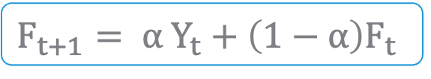
Single Exponential Smoothing Model
Mathematical Model :
Where,
F_{t+1} : Forecast value for period t + 1
F_{t} : Forecast value for period t
Y_{t} : Actual value for period t
α : Alpha (Smoothing constant)
$$F_{t+1}= α Y_{t}+\left(1−α\right)F_{t}$$

Slide 5
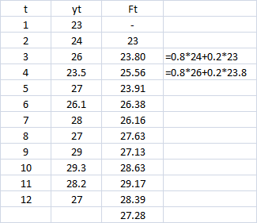
Single Exponential Smoothing Model
Assume α=0.8
*
1st future value will always be the previous value & then for rest future values exponential smoothing mathematical formula is applied.

Slide 6
Single Exponential Smoothing Model - Smoothing Constant α
Values of α
close to one → have less of a smoothing effect and give greater weight to recent changes in the data
closer to zero → have a greater smoothing effect and are less responsive to recent changes
There is no formally correct procedure for choosing α. Sometimes the statistician’s judgment is used to choose an appropriate factor.
Alternatively, α can be decided based on statistical measure such as Root Mean Squared Error.

Slide 7
Get an Edge!
Why the Name “Exponential”?
This method gives weights to past observation in exponentially decreasing manner.
F_{t+1}= α y_{t} + α(1- α) y_{t -1} + α(1- α)² y_{t} ₋₂ + α(1- α)³ y_{t -3}-----
= α y_{t} + (1- α) [α y_{t} -₁ + α(1- α) y_{t -2} + α(1- α)² y_{t -3}----]
= α y_{t} +(1- α) F_{t}
Larger alpha gives more weight to recent values.

Slide 8
Case Study
Background
Objective
Available Information
Sales Data for 3 Years (2013, 2014, 2015)
To apply Decomposition & Exponential Smoothing to Time Series data using different methods.
Variables: Year, Month, Sales
Sample size is 36

Slide 9
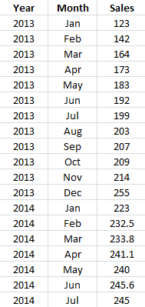
Data Snapshot
Sales Data for 3 Years
Variables
Monthly Observations
Columns | Description | Type | Measurement | Possible values
Year | Year | factor | 2013, 2014, 2015 | 3
Month | Month | factor | Jan - Dec | 12
Sales | Sales in USD Million | numeric | USD Million | Positive values

Slide 10
Simple Exponential Smoothing in Python
# Import data
import pandas as pd salesdata = pd.read_csv("Sales Data for 3 Years.csv") rng = pd.date_range('2013','2016',freq='M') s = salesdata.Sales.values salesseries = pd.Series(s, rng)
freq = tells Python the frequency of time period in the data, ‘M’ for monthly data.
pd.Series() converts a column from a data frame to a simple time series object.

Slide 11
Simple Exponential Smoothing in Python
#Single Exponential Smoothing
from statsmodels.tsa.holtwinters import SimpleExpSmoothing model = SimpleExpSmoothing(salesseries) fit1 = model.fit() fit1.predict() fit1.summary()
SimpleExpSmoothing() from holtwinters in statsmodels undertakes exponential smoothing.

Slide 12
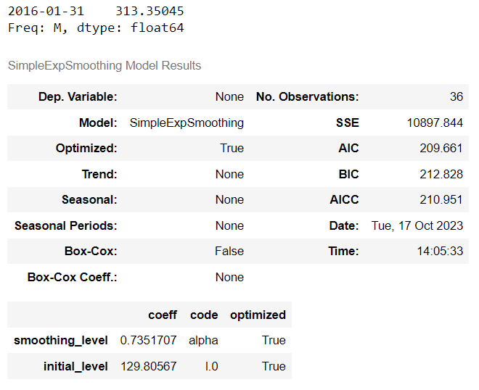
Simple Exponential Smoothing in Python
# Output
Predicted value
alpha
Interpretation :
It returns predicted future value & value of alpha.

Slide 13
Double (Holt) and Triple(Holt-Winters) Exponential Smoothing Methods
Double exponential smoothing has two equations
First equation is similar to single exponential smoothing method
Second equation updates trend using constant beta.
Double exponential smoothing method is used when there is a trend in the time series.
Triple exponential smoothing has three equations
First 2 equations are similar to double exponential smoothing method
Third equation updates seasonal component using constant gamma.
Triple exponential smoothing method is used when there is trend + seasonality in the time series.

Slide 14
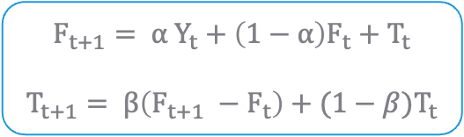
Double Exponential Smoothing Model
Mathematical Model :
Where,
F_{t+1} : Forecast value for period t +1
F_{t} : Forecast value for period t
T_{t} : Trend component for period t
T_{t+1} : Trend component for period t +1
Y_{t} : Actual value for period t
α : Alpha (Smoothing constant)
β : Beta (Second smoothing constant)
$$F_{t+1}= α Y_{t}+\left(1−α\right)F_{t}+T_{t}$$
$$T_{t+1}= β\left(F_{t+1} −F_{t}\right)+(1−β)T_{t}$$

Slide 15
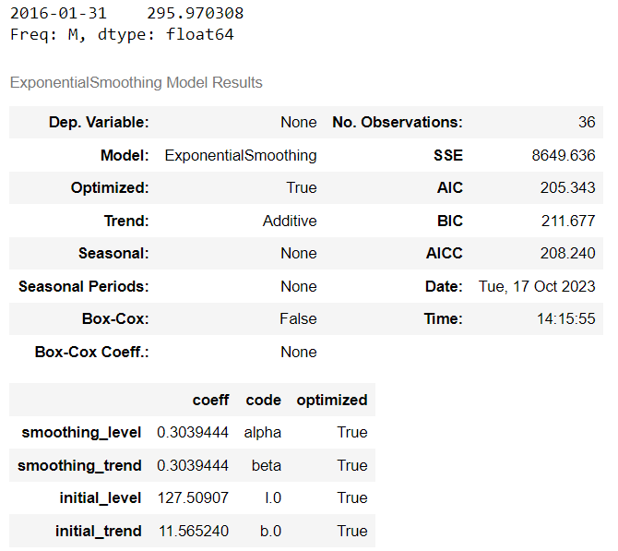
Double Exponential Smoothing in Python
#Double Exponential Smoothing
from statsmodels.tsa.holtwinters import ExponentialSmoothing model = ExponentialSmoothing(salesseries, trend='add',seasonal = None) fit2 = model.fit() print(fit2.predict()) fit2.summary()
# Output
Predicted value
Interpretation :
It returns predicted future value, value of alpha and beta.
alpha, beta

Slide 16
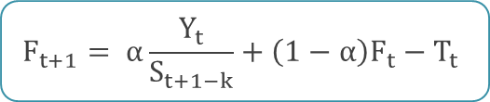

Triple Exponential Smoothing Model
Mathematical Model :
where,
$$F_{t+1}= α\frac{Y_{t}}{S_{t+1−k}}+\left(1−α\right)F_{t}−T_{t}$$
$T_{t+1}= β\left(F_{t+1} −F_{t}\right)+\left(1−β\right)T_{t}$ $S_{t}= γ\frac{Y_{t}}{F_{t−k}}+\left(1−γ\right)S_{t+1−k}$
S_{t+1-k} : Seasonal smoothing value for period t +1
F_{t} : Forecast value for period t
F_{t+1} : Forecast value for period t +1
F_{t} : Forecast value for period t
T_{t} : Trend component for period t
T_{t+1} : Trend component for period t +1
Y_{t} : Actual value for period t
α : Alpha (Smoothing constant)
β : Beta (Second smoothing constant)
$γ$ : Gamma (Third smoothing constant)

Slide 17
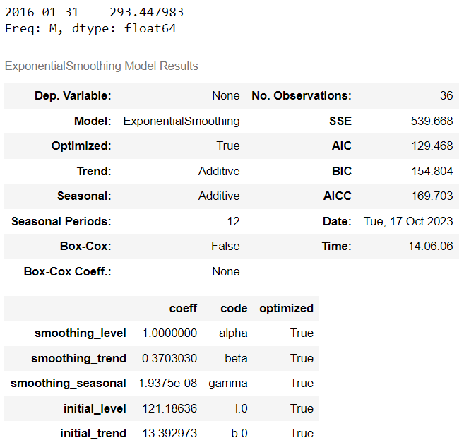
Triple Exponential Smoothing in Python
#Triple Exponential Smoothing
from statsmodels.tsa.holtwinters import ExponentialSmoothing model = ExponentialSmoothing(salesseries,seasonal_periods=12, trend='add', seasonal='add') fit3 = model.fit() print(fit3.predict()) fit3.summary()
Interpretation :
It returns predicted future value & value of alpha, beta and gamma.
# Output
Predicted value
alpha, beta, gamma

Slide 18
Get an Edge!
Always approach time series analysis in a systematic manner
Analyse
Analyse trend and seasonality present in the data
Decompose
Decompose time series into its components
Forecast
Forecast future values of the time series
For vector time series, investigate connections between two or more time series with the aim of using values of some of the processes to predict those of the others. (Eg. Pairs trading in stock market)

Slide 19
Quick Recap
In this session, we learnt about exponential smoothing:
Smoothing
Smoothing gives weights to past observations, in order to give more significance to seasonality and trend components of a time series
Smoothing in Python
From statsmodels.tsa.holtwinters :
Use SimpleExpSmoothing() to carry out simple exponential smoothing
Use ExponentialSmoothing() to carry out double and triple exponential smoothing

